Slide 1
FINAL PROJECT BIG DATA TECHNOLOGY Static Data simulate Streaming For Mercedes Car statitstics.
Full Name: Henok Semere Kifleyesus
Student ID: 611090
Professor:
Mrudula Mukadam

Slide 2
Objective: Implementation of a Big Data Pipeline
Technology Set
Apache Kafka
Spark Streaming
Apache Hive
Hbase
Tableau

Slide 3
Introduction
Data source : Static Data of Mercedes Cars

Slide 4
FLOW OF Data STREAMING
Spark Streaming - > Kafka Producer -> Kafka Broker & Topic -> Kafka SparkStreaming Consumer -> Hbase
Hive Table ON Top of Hbase
Hbase on top of ->Tableau

Slide 5
Kafka
Kafka is a distributed streaming platform that publish and subscribe to streams of records, similar to a message queue or enterprise messaging system. It stores streams of records in a fault-tolerant durable way and process streams of records as they occur. In this project, Kafka is used to receive the streams of data from Static simulation data(csv) and forwards it to the Spark Streaming.

Slide 6
KAFKA PRODUCER
Kafka Stream component built to support ETL(Extract, Transform, Load) type of message transformation. Means to input stream from topic, transform and output to other topic. It support real-time processing and same time support advance analytic features such as aggregation, windowing , join etc.

Slide 7
(5)DATA VISUALIZATION
DataVisualization is the practice of translating information into a visual context, such as a map or graph like pie charts, histograms ...etc. The main goal of data visualization is to make it easier to identify patterns, trends and outliers in large data set and helps to predict for the future what going on.
# benefits of data visualization include:
=>The ability to absorb information quickly, improve insights and make faster decisions;
=>An increased understanding of the next steps that must be taken to improve based on the data analysis

Slide 8
(5)Data Visualization with Tableau(continue)
Tableau is a visualization tool based on breakthrough technology that provides drag & drop features to analyze data on large amounts of data very easily and quickly.
The Dashboard of Tableau is very interactive and gives dynamic results. Tableau supports strong interactive capabilities and provides rich set of graphic charts. Tableau can query relational databases, cubes, cloud database, and spreadsheets and then generates a number of graph types that can be combined into dashboards and shared over a computer network or the internet.

Slide 9
# Connecting to Hive through tableau and steps we have to follow.
I have downloaded Tableau and Cloudera Hive ODBC driver.

Slide 10
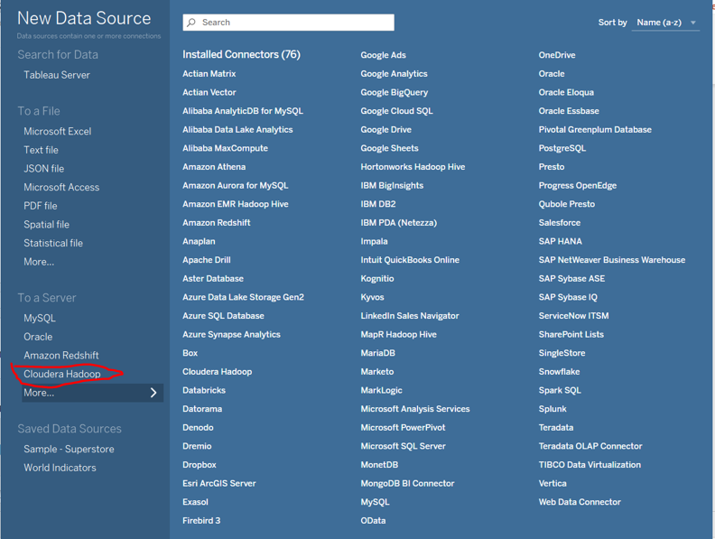
B, I have to choose cloudera hadoop to connect with the hive server running in our cloudera VM

Slide 11
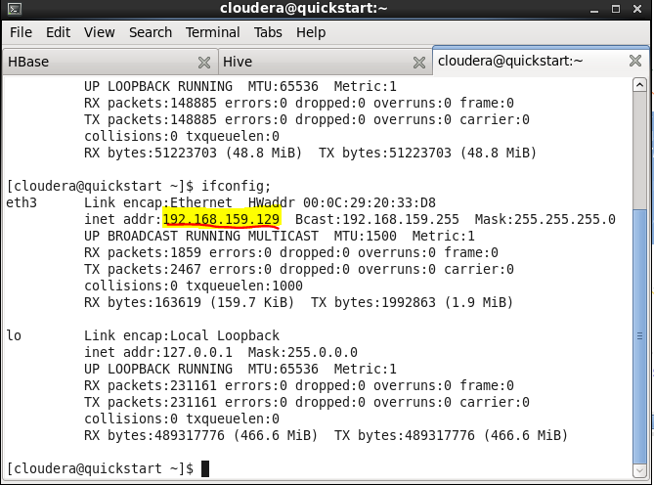
C, Then I am using the server name/IP address and the user with correct authentication type to connect to the server.

Slide 12
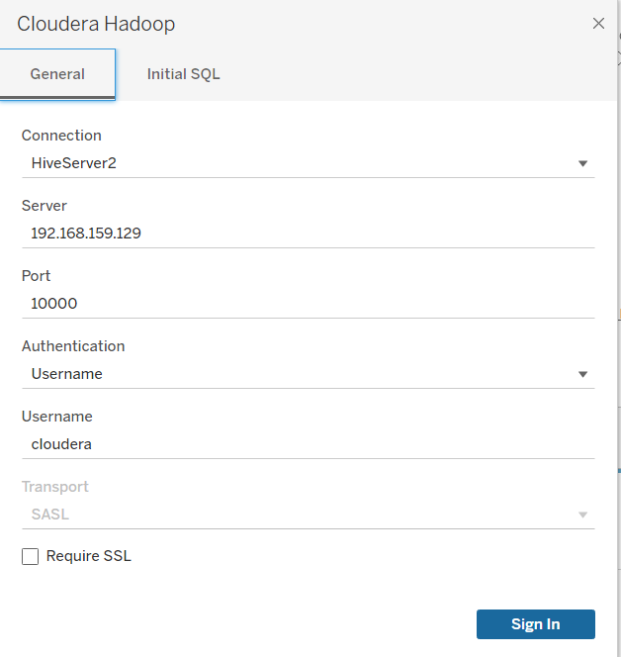

Slide 13
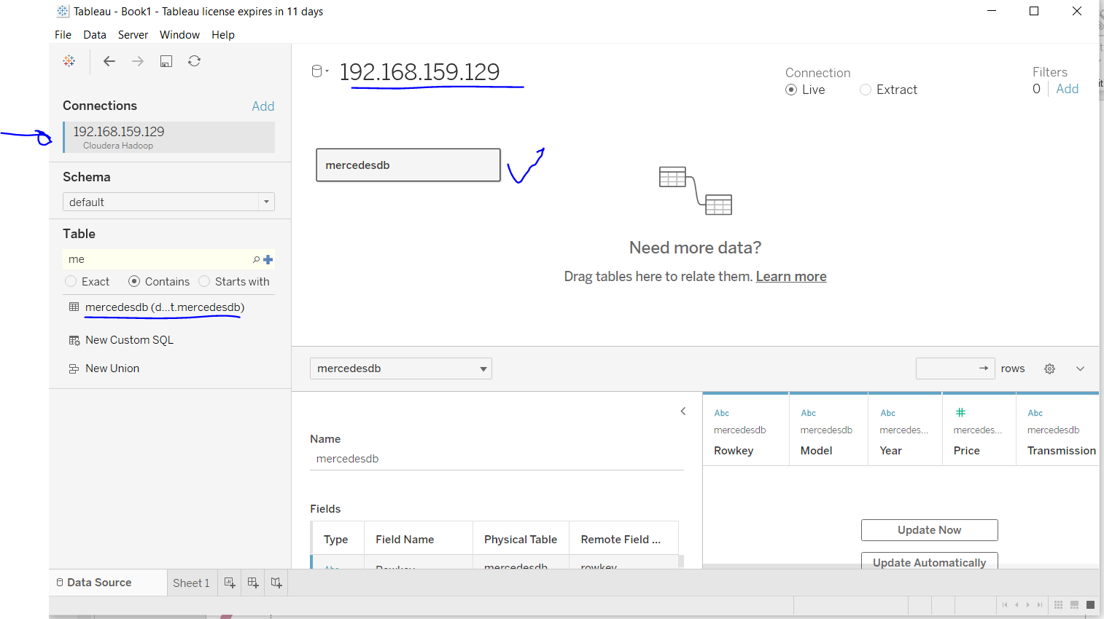
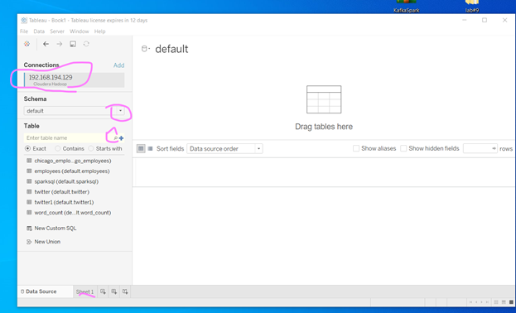
D. Finally we can search the schema and table, then we can access it what we have in the hive.

Slide 14
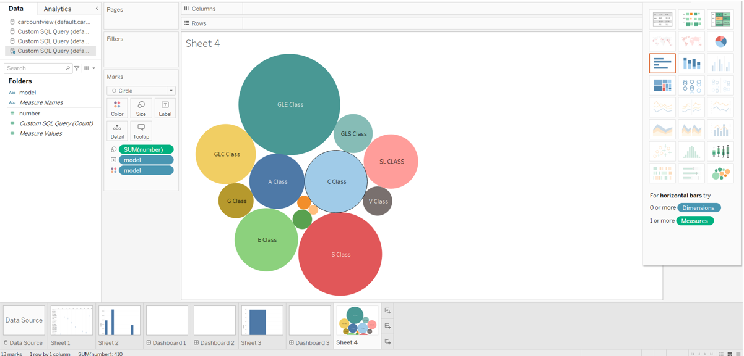
Visualization 1: Sum or Total Numbers of Mercedes Models only Greater than $50,000 Prices

Slide 15
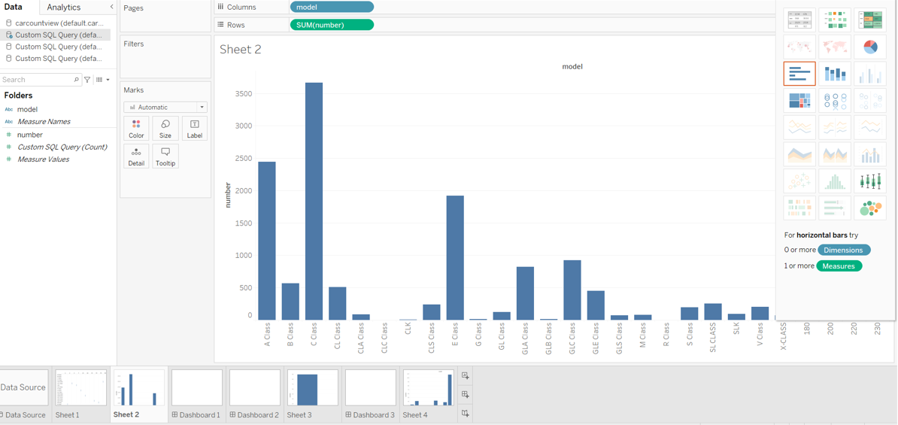
Visualization 2: Count All Merceds Models

Slide 16
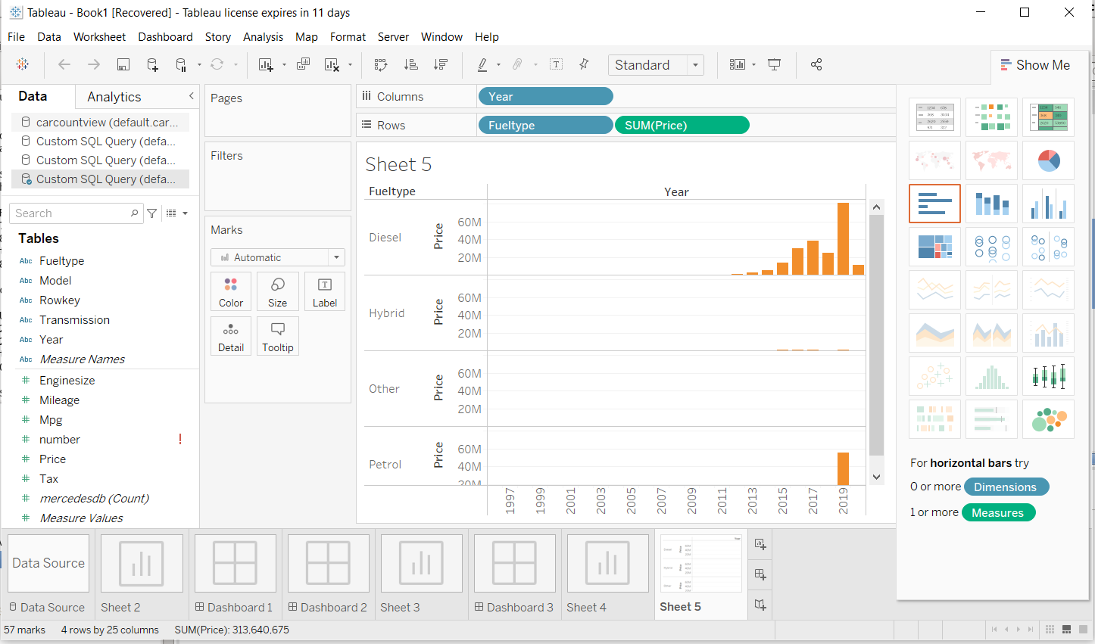
Visualization 3: Total Prices Mercedes Has sell in the recent Years per FuelType

Slide 17

THANK YOU !!!
At last, but not least I wanted to take this advantage to appreciate for all the effort you put to teach us this interesting course. Kindly note that I am not shy to say that you are one of my fav Professors who has taught me.
Once again Thank you for making this course Interesting.

